Slide 1
Knowledge Representation
&
Predicate Logic
Professor Dr. A K M Akhtar Hossain
Dept. of CSE, RU

Slide 2
Knowledge Representation
Knowledge representation (KR) is an important issue in both cognitive science and artificial intelligence.
  In cognitive science, it is concerned with the way people store and process information.
  In artificial intelligence (AI), main focus is to store knowledge so that programs can process it and achieve human intelligence.
Knowledge representation in AI is not just about storing data in a database, it allows a machine to learn from that knowledge and behave intelligently like a human being.

Slide 3
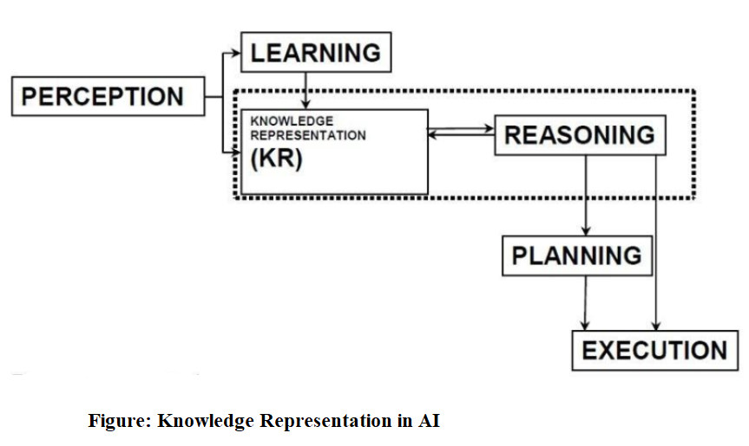
Knowledge Representation

Slide 4
Components of knowledge Representation system
The knowledge representation function contains the following components.
Perception
Learning
KR and Reasoning
Planning and Execution

Slide 5
Components of knowledge Representation system
Perception helps in extracting the information and can be helpful in telling us the status of AI system. It can detect any irregularity in the system and make us ready to decide whether an AI system has the potentiality of damage or not.
Learning component captures the data which are already sensed by the perception component. Learning component tries to enable the computer to learn just like human instead of always programming it. This component solely tries to focus on how to self-improve the AI system.

Slide 6
Components of knowledge Representation system
KR and reasoning are used in AI to acquire knowledge in the smartest way. It focuses on the behavior of an AI agent and make sure that it more or less behaves like human. It is used to formalize the knowledge in the knowledge base.
Planning and execution try to find the optimal solution of the current state and tries to understand the impact of the same. Now it tries to seek out the solution that the final state holds and then it will try to terminate the entire process with a solution here itself.

Slide 7
Applications of Knowledge Representation
Knowledge representation and reasoning are powerful tools that can be used to build intelligent systems.
By representing knowledge in a computer-readable format, and by using reasoning to solve problems.
AI applications can perform tasks that would be difficult or impossible for humans to do.

Slide 8
Applications of Knowledge Representation
Knowledge representation makes complex software easier to define and maintain than procedural code and can be used in expert system
Reasoning is the use of symbolic representations of some statements in order to derive new ones.

Slide 9
What is predicate logic (PL)?
A predicate logic is an expression of one or more variables defined on some specific domain.
A predicate with variables can be made a proposition by either assigning a value to the variable or by quantifying the variable.

Slide 10
Predicate logic (PL):
A predicate is a statement that contains variables (predicate variables), and they may be true or false depending on the values of these variables.
Predicate logic is the generic term for symbolic formal systems like first-order logic, second-order logic, many-sorted logic, or infinitary logic.

Slide 11
Predicate Logic (PL):
The Predicate Logic has three logical notions.
  Term,
  Predicate
  Quantifier
(1). Term:
  a constant (single individual or concept i.e.,5, john etc.),
  a variable that stands for different individuals
  n-place function f(t₁, …, t_{n}), where t₁, …, t_{n} are terms.
  A function is a mapping that maps n terms to a term.

Slide 12
Predicate Logic (PL):
Predicate:
  a relation that maps n terms to a truth value (T) or false value (F).
Quantifier:
  Universal (∀) quantifier
  Existential(∃) quantifier
  ∀ and ∃ are used for conjunction with variables.

Slide 13
Examples
“x loves y” is represented as LOVE(x, y) which maps it to true or false, when x and y get instantiated to actual values.
“john’s father loves john” is represented as LOVE(father(john), john).
  Here father is a function that maps john to his father.

Slide 14
Examples
x is greater than y is represented in predicate calculus as GT(x, y).
It is defined as follows:
GT( x, y) = T , if x > y
= F , otherwise
Symbols like GT and LOVE are called predicates .
  Predicates two terms and map to T or F depending upon the values of their terms.

Slide 15
Examples – Cont..
Translate the sentence "Every man is mortal" into Predicate formula.
Representation of statement in predicate form
  “x is a man” and “MAN(x),
  x is mortal” by MORTAL(x)
Every man is mortal :
(∀x) (MAN(x) → MORTAL(x))
Here, ∀x is read as “for all x” and → is read as “implies”.

Slide 16
Syntax and semantics for Propositional Logic
Valid statements or sentences in PL(Predicate Logic) are determined according to the rules of propositional syntax.
This syntax governs the combination of basic building blocks such as propositions and logical connectives.
Propositions are elementary atomic sentences.

Slide 17
Cont……
Propositional Logic may be either true or false but may take on no other value.
Examples (Simple propositions):
  It is raining.
  It is a shining day.
  Snow is white.
  Snow is black.
  People live on the Earth.
  People live on the Moon.

Slide 18
Cont….
Examples (Compound propositions):
  It is raining and the wind is blowing.
  If you study hard you will be rewarded.
  The sum of 10 and 20 is not 40.
  The sum of 20 and 10 is 40.
T and F are special symbols having the values true and false.

Slide 19
Conti…
Logical Connectives:
Symbol | Meaning
˜ | for not or negation
& | for and or conjunction
v | For or or disjunction
→ | For if … then or implication
↔ | For if and only if or double implication

Slide 20
Syntax
The syntax of PL is defined recursively as follows:
T and F are formulas.
IF P and Q are formulas, the following are also formulas:
(˜P)
(P&Q)
(PVQ)
(P→Q)
(P↔Q)

Slide 21
Examples
1. Marcus was a man.
PL: Man(Marcus)
2. Marcus was a Pompeian.
PL: Pompeian(Marcus)
3. All Pompeian's were Romans.
PL: ∀x :Pompeian(x) → Roman(x)
4. Caesar was a ruler.
PL: Rular(Caesar)

Slide 22
Examples
Represent the following facts in predicate logic:
(i). All employees earning Tk. 3,00,000/= or more per year have to pay taxes.
∀x ((E(x) & GE(i(x), 300000)) →T(x))
(ii). People only try to assassinate rulers they are not loyal to.
∃y: ∀x : person(x) Ʌ ruler(y) Ʌ tryassassinate(x, y) → ¬loyalto (x, y)
(iii). John likes all kinds of food.
Like (john, all-kinds-of-food)

Slide 23
Semantics
The semantics or meaning of a sentence is just the value true or false: that is, it is as assignment of a truth value to the sentences.
An interpretation for a sentence or group of sentences in an assignment of the truth value to each propositional symbol.

Slide 24
Conti…
Example: Consider the statement = (P & ~Q)
Clearly, there are four distinct interpretations for this sentences.
Interpretation | P | Q
1 | True | False
2 | True | True
3 | False | True
4 | False | False

Slide 25
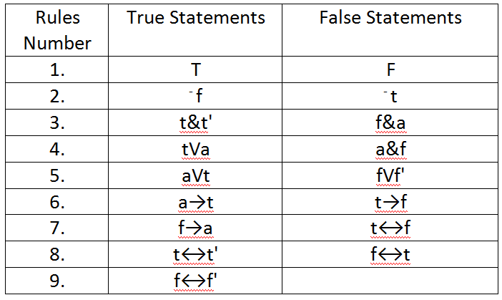
Semantic Rules for statements
Consider t and t' denotes true statements, f and f' denotes false statements, and a is any statement.

Slide 26
Example:
Let I assign true to P , false to Q and false to R in statement = ((P & ⁻Q) →R)VQ.
What is the meaning of the statement?
Answer:
Rule 2 gives ⁻Q as true.
Rule 3 gives (P & ⁻Q) as true.
Rule 6 gives (P & ⁻Q) →R as false.
Rule 5 gives the statement ((P & ⁻Q) →R)VQ value as false.

Slide 27
Assignment-3
Let I assign true to A , false to B, false to Q and true to R in statement = ((A & ~B) →R)V (~Q V R) .
What is the meaning of the statement?
Sol: True.

Slide 28
THE END
THANKS

